Slide 1
Upliance.ai
Key Insights and Report

Slide 2
Key Findings and Insights

Slide 3
Intro
Hello everyone, I am Lokesh.
This presentation is about the key findings and insights about the Cooking and Food ordering data. These findings help to make informed decisions and make business recommendations.

Slide 4
First point
The data used here contains 3 data sources
User details - User ID, Name, Age, Location, Registration Date, Phone, Email, Favorite Meal, Total orders.
Cooking Sessions - Session ID, User ID, Dish Name, Meal Type, Session Start, Session End, Duration (mins), Session Rating.
Order Details - Order ID, User ID, Order Date, Meal Type, Dish Name, Order Status, Amount (USD), Time of Day, Rating, Session ID.

Slide 5
Second point
The data is converted to a Dataframe and preprocessed to clean and arrange the data to perform the analysis.

Slide 6
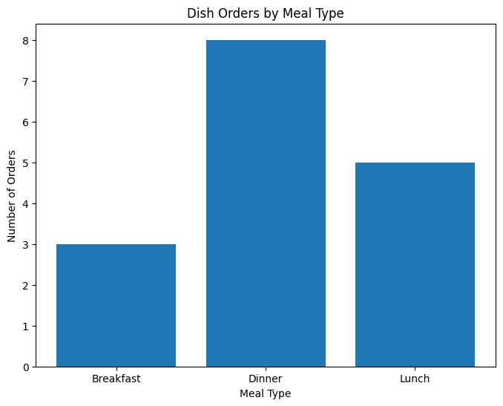
Key Observations:
Dinner is the most popular meal: It has the highest number of orders.
Breakfast has the fewest orders: It has the lowest number of orders among the three.
Lunch has a moderate number of orders: It falls between Breakfast and Dinner in terms of order volume.

Slide 7
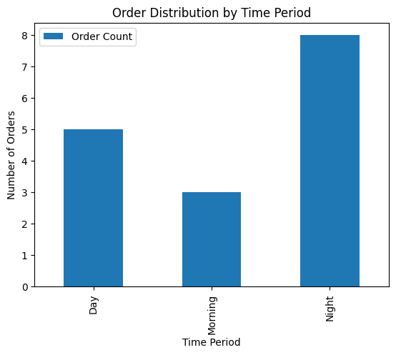
Key Observations:
Night has the highest number of orders.
Day has the second-highest number of orders.
Morning has the lowest number of orders.

Slide 8
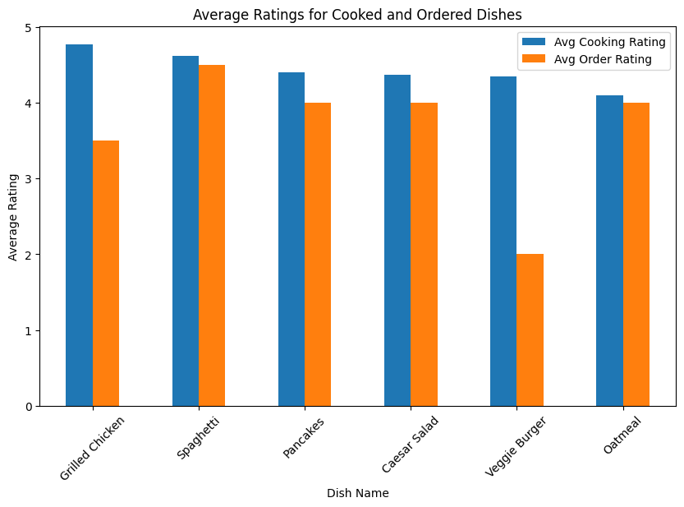
Key Observations:
Grilled Chicken and Spaghetti have the highest average ratings for both cooking and ordering.
Oatmeal has a significantly lower average rating for cooking compared to ordering.
Caesar Salad has a higher average rating for cooking than for ordering.
Pancakes, Veggie Burger, and Oatmeal have relatively similar average ratings for both cooking and ordering.

Slide 9
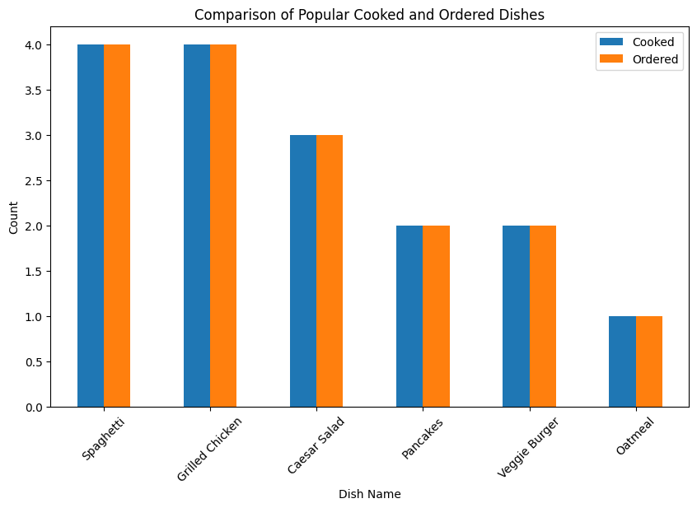
Key Observations:
Spaghetti and Grilled Chicken are the most popular dishes, both when cooked and ordered.
Caesar Salad is more popular when cooked than ordered.
Pancakes, Veggie Burger, and Oatmeal have similar popularity levels for both cooking and ordering.

Slide 10
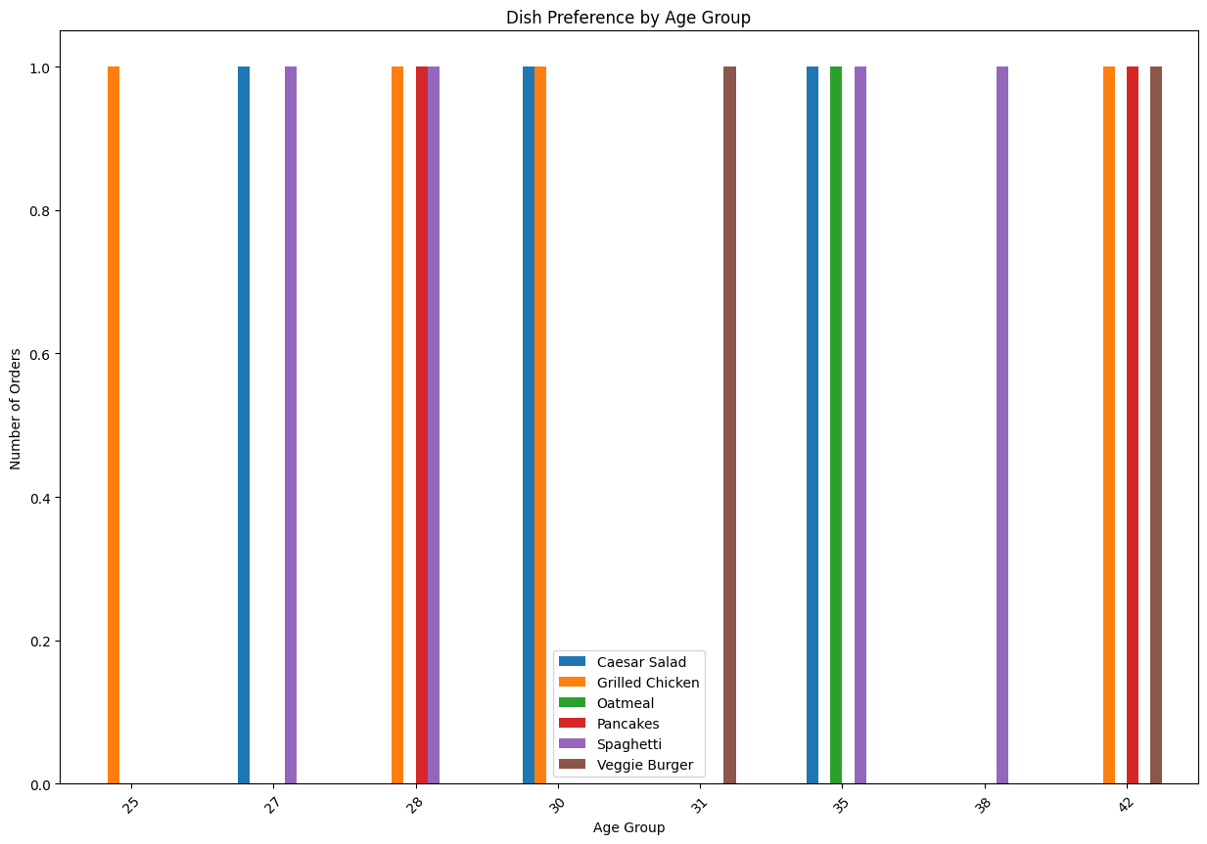
Key Observations:
Spaghetti and Grilled Chicken consistently remain popular across all age groups.
Caesar Salad and Pancakes also show significant popularity across different age groups.
Veggie Burger and Oatmeal seem to be less popular compared to the other dishes, especially among younger age groups.

Slide 11
Business Recommendations
Focus on Dinner Offerings:
Since Dinner is the most popular meal, prioritize offering a diverse and high-quality dinner menu.
Consider introducing special dinner promotions or combos to attract more customers.
Highlight Popular Dishes:
Promote Grilled Chicken and Spaghetti as popular choices, especially emphasizing their high ratings when cooked.
Use these dishes to attract new customers and encourage repeat business.
Optimize Nighttime Operations:
Ensure adequate staffing and inventory levels during the night to meet the increased demand.

Slide 12
Business Recommendations
Enhance Breakfast Options:
Analyze why Breakfast orders are lower and implement strategies to increase demand.
Consider offering breakfast specials or combos to attract customers.
Explore options like breakfast buffets or delivery services to attract more customers.
Optimize Lunch Menu and Service:
Maintain a balanced lunch menu to cater to different preferences.
Focus on efficient service during lunch hours to avoid long wait times.
Improve Oatmeal Preparation:
Analyze the reasons for the lower average rating for cooked oatmeal.
Consider adjusting the recipe, cooking method, or presentation to improve its taste and appeal.
Offer more variety in oatmeal toppings or flavors to enhance the experience.
Leverage Caesar Salad Popularity:
Since Caesar Salad has a higher average rating when cooked, consider promoting it as a specialty dish.
Offer different variations or unique twists on the classic Caesar Salad recipe.

Slide 13
Business Recommendations
Enhance the Appeal of Veggie Burger and Oatmeal:
Analyze the reasons for the lower popularity of Veggie Burger and Oatmeal, especially among younger age groups.
Consider offering more variety in Veggie Burger options or improving the taste and presentation of Oatmeal.
Introduce new and innovative dishes to cater to younger customers' preferences.
Tailor Menu Offerings:
While Spaghetti and Grilled Chicken are popular across all age groups, consider offering age-specific variations or healthier options to cater to different preferences.
For instance, you could offer lighter versions of dishes for older customers or more adventurous options for younger customers.
Gather Customer Feedback:
Continuously monitor order trends and customer preferences.
Use data analytics to identify peak hours and adjust staffing accordingly.
Conduct surveys or feedback forms to collect customer opinions on the taste, presentation, and overall experience of each dish.
Use this feedback to identify areas for improvement and make data-driven decisions.

Slide 14
“Data is the new competitive advantage”
- Gary Loveman

Slide 15

Thanks!
Contact:
A Lokesh
7502387612
lokeshanbu1997@gmail.com

